Slide 1
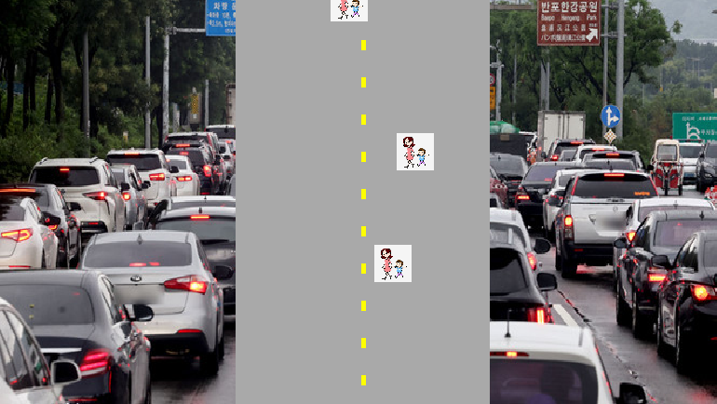
"Rush Hour Scooter Commute"
20161132 JUNG YOONSEOK

Slide 2
Tables
Game play
Changes in the Game
Remaining Tasks

Slide 3
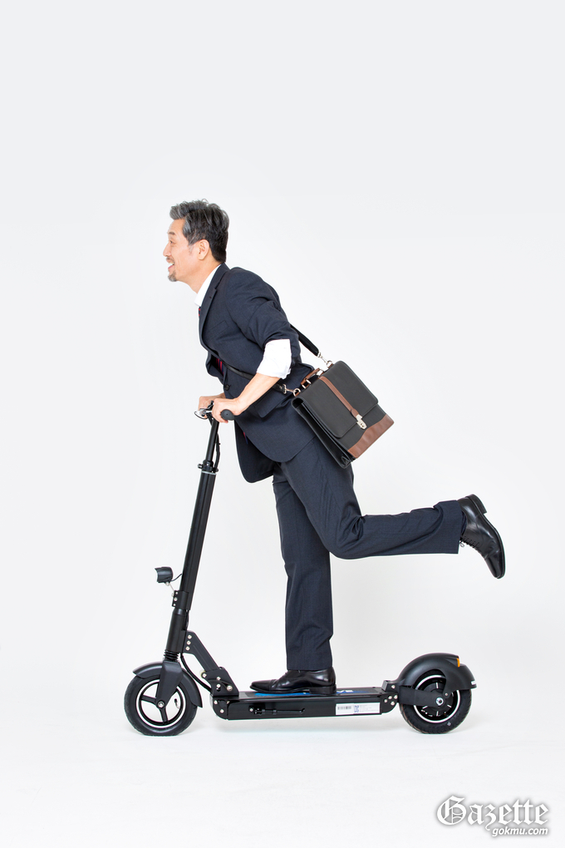
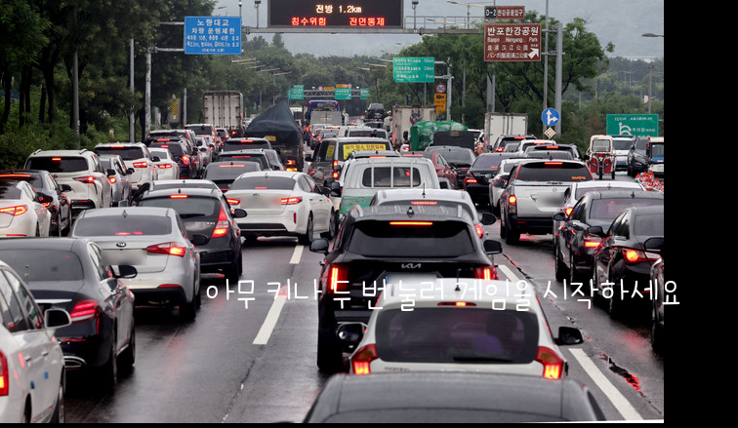
Gameplay:
Start Screen and Scooter Setup:
The game begins as the player, a corporate worker, realizes they are running late for work.
With a sense of urgency, the player presses any key twice to swiftly start the scooter journey.
Scooter Movement and Controls:
Left Key: Move the scooter to the left.
Right Key: Move the scooter to the right.
Up Key: Accelerate the scooter to move faster.
Down Key: Navigate downward cautiously.
Road and Obstacles:
The dynamic road width reflects the chaotic city streets during rush hour.
Various obstacles, symbolizing typical commuter challenges, appear on the road.

Slide 4


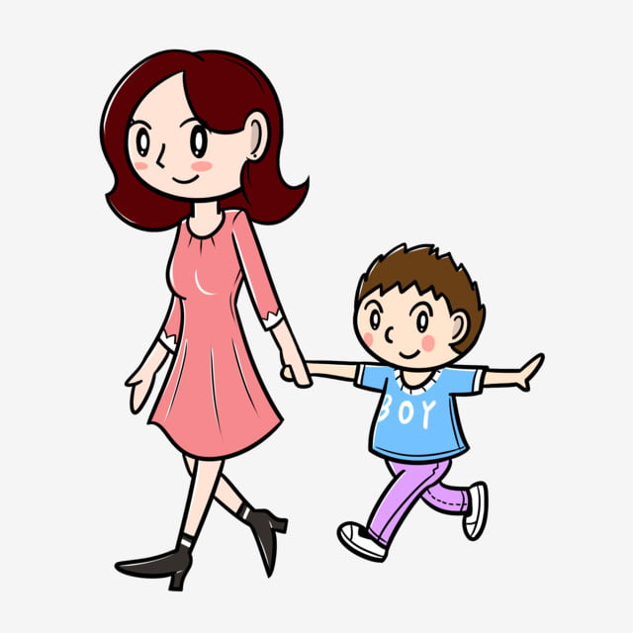

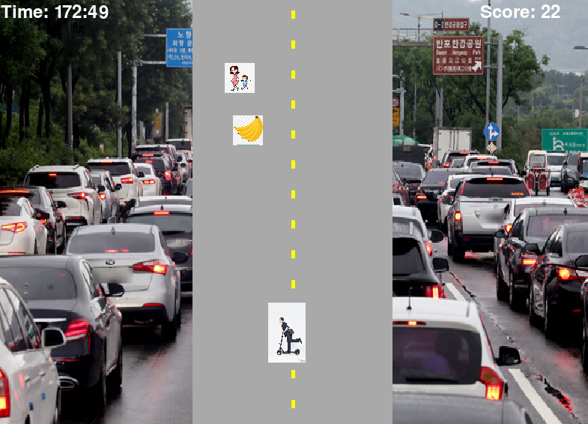
Gameplay:
4. Types of Obstacles:
Traffic lights, banana peels, cars, and mothers with children represent the chaos of a busy morning.
Collisions result in point deductions, simulating the setbacks of a hurried commute
5. Increasing Difficulty:
As the game progresses, the city's morning rush intensifies, increasing scooter speed, obstacle frequency, and road complexity.

Slide 5
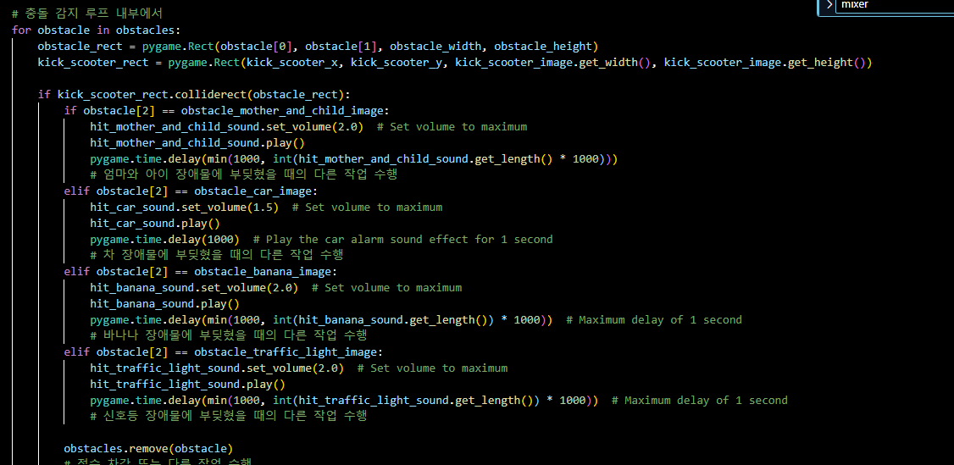
Changes in the Game:
Music and Sound Effects:
Energetic music sets the pace, intensifying as the rush hour commute becomes more challenging.
Collision events trigger sound effects, enhancing the immersive experience.

Slide 6
Remaining Tasks
Sound Effects
Background Music
Increasing difficulty by narrowing the road

